Slide 1
TTP - Elmer Hour
Presented By
@Slevin & @randombullshitusername

Slide 2
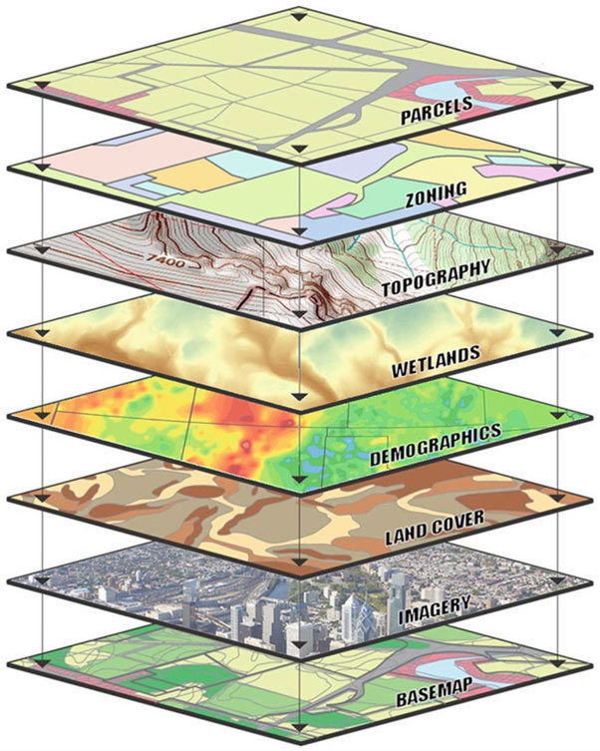
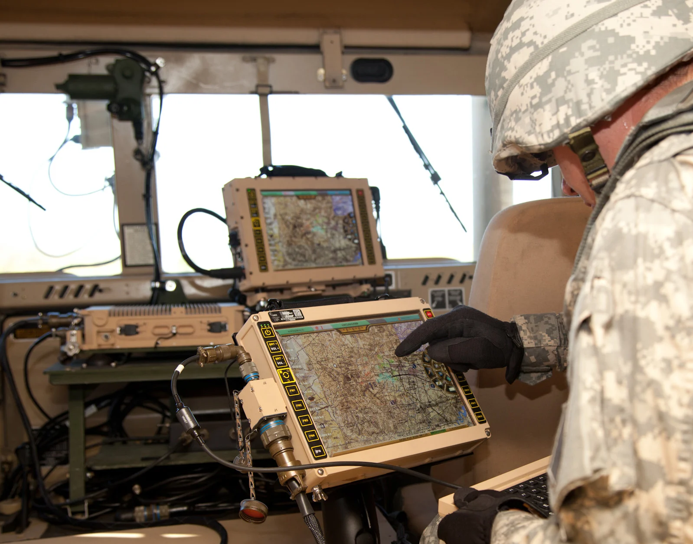
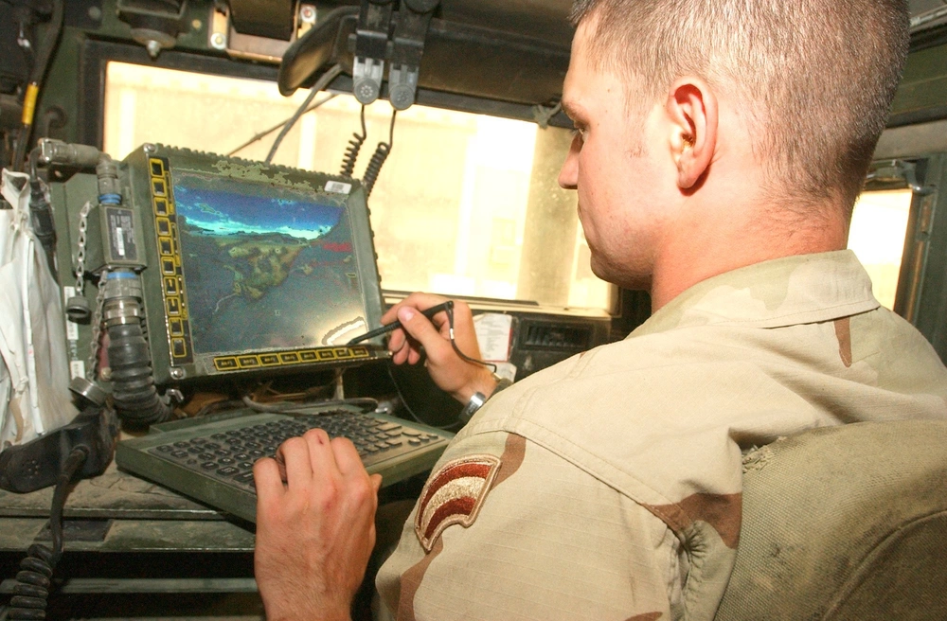
Overview
Team Awareness Kit (TAK)
ATAK
WinTAK
iTAK
Notes:
Collection of apps used to share and track data, typically in a geospatial manner
Think Blue Force Tracking meets Microsoft Teams

Slide 3
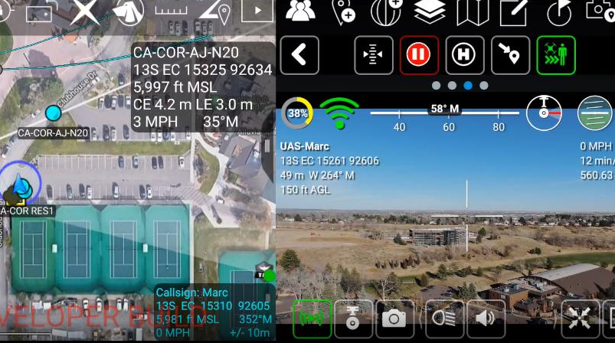
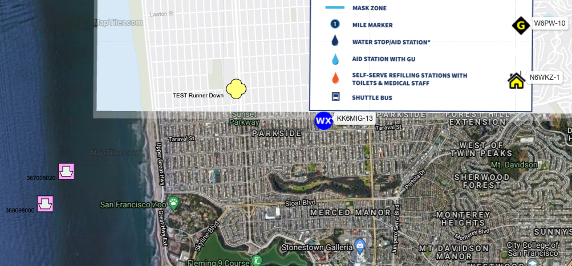
Use Cases:
Single dashboard for situational awareness with customized information:
Video streams
APRS
ADS-B
Meshtastic
Notes:
Why
Create a God’s Eye view of our AO

Slide 4
Capabilities:
DTED Resolution:
DTED Level 0 corresponds to small scale hardcopy products and has a post spacing of 30 arc-seconds, or one-kilometer nominal resolution.
DTED Level 1 corresponds to medium scale hardcopy products and has a post spacing of three arc-seconds, or 100-meter nominal resolution.
DTED Level 2 corresponds to medium to large scale hardcopy products and has a post spacing of one arc-second-, or 30-meter nominal resolution.
Basically, the higher the level of DTED the more accurate the elevation data is.
Notes:
Digital Terrain Elevation Data

Slide 5
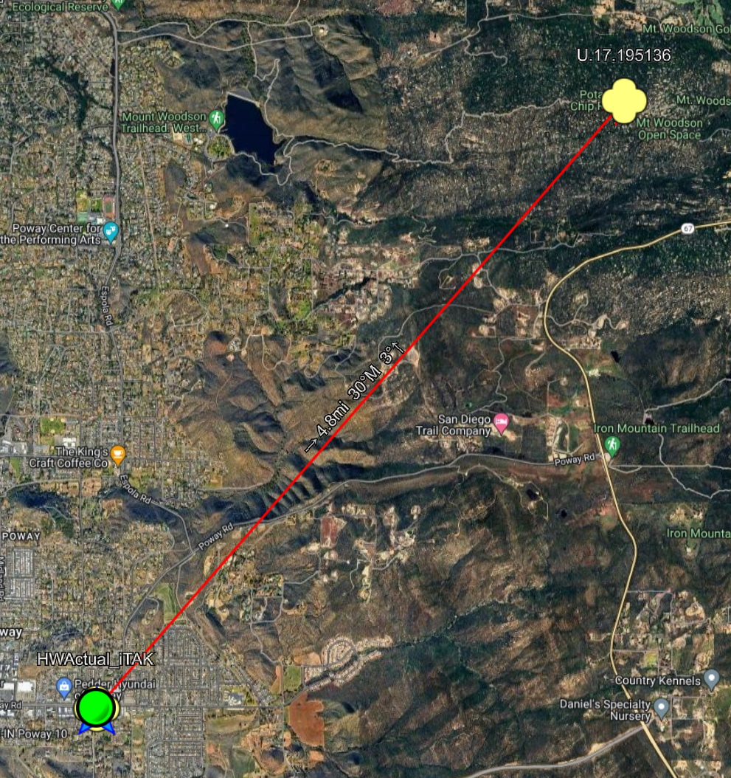
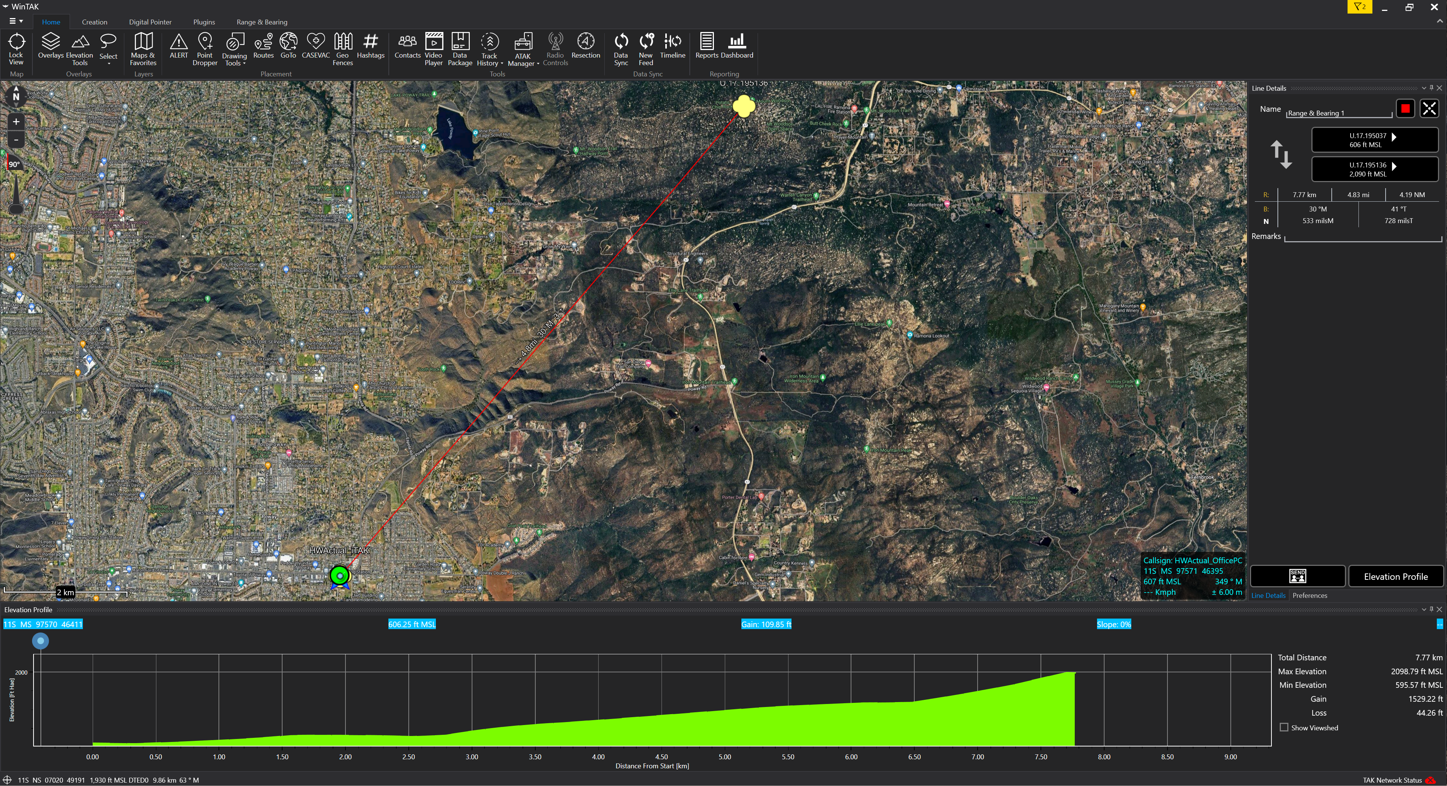
Capabilities:
Geospatial Tools
Notes:
Distances between points
Elevation data

Slide 6
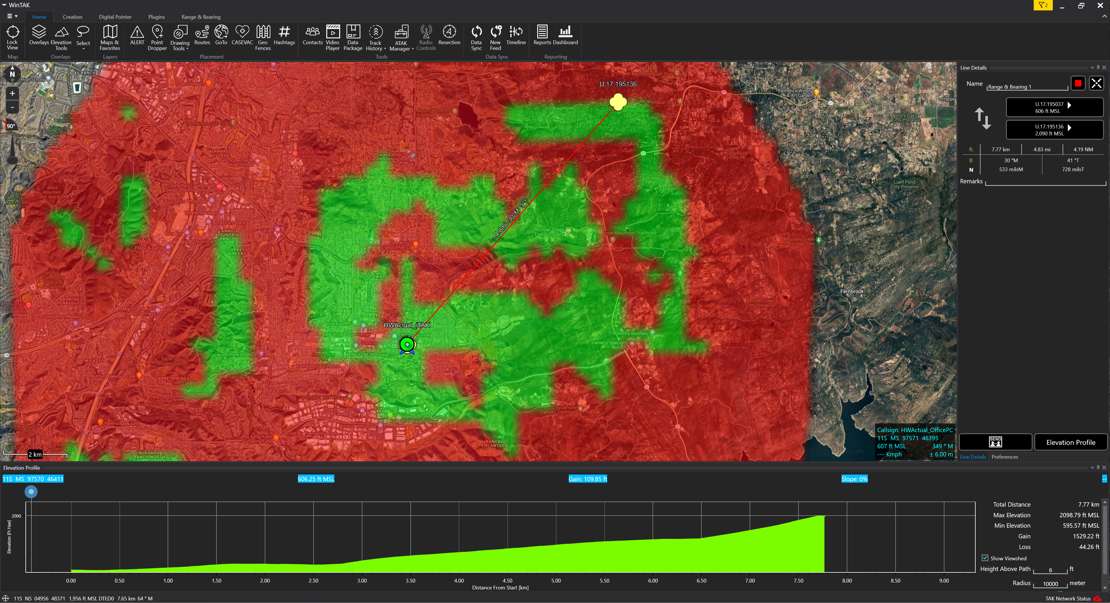
Capabilities:
Geospatial Tools
Notes:
Viewsheds
Rf propagation planning
Clandestine comms planning

Slide 7
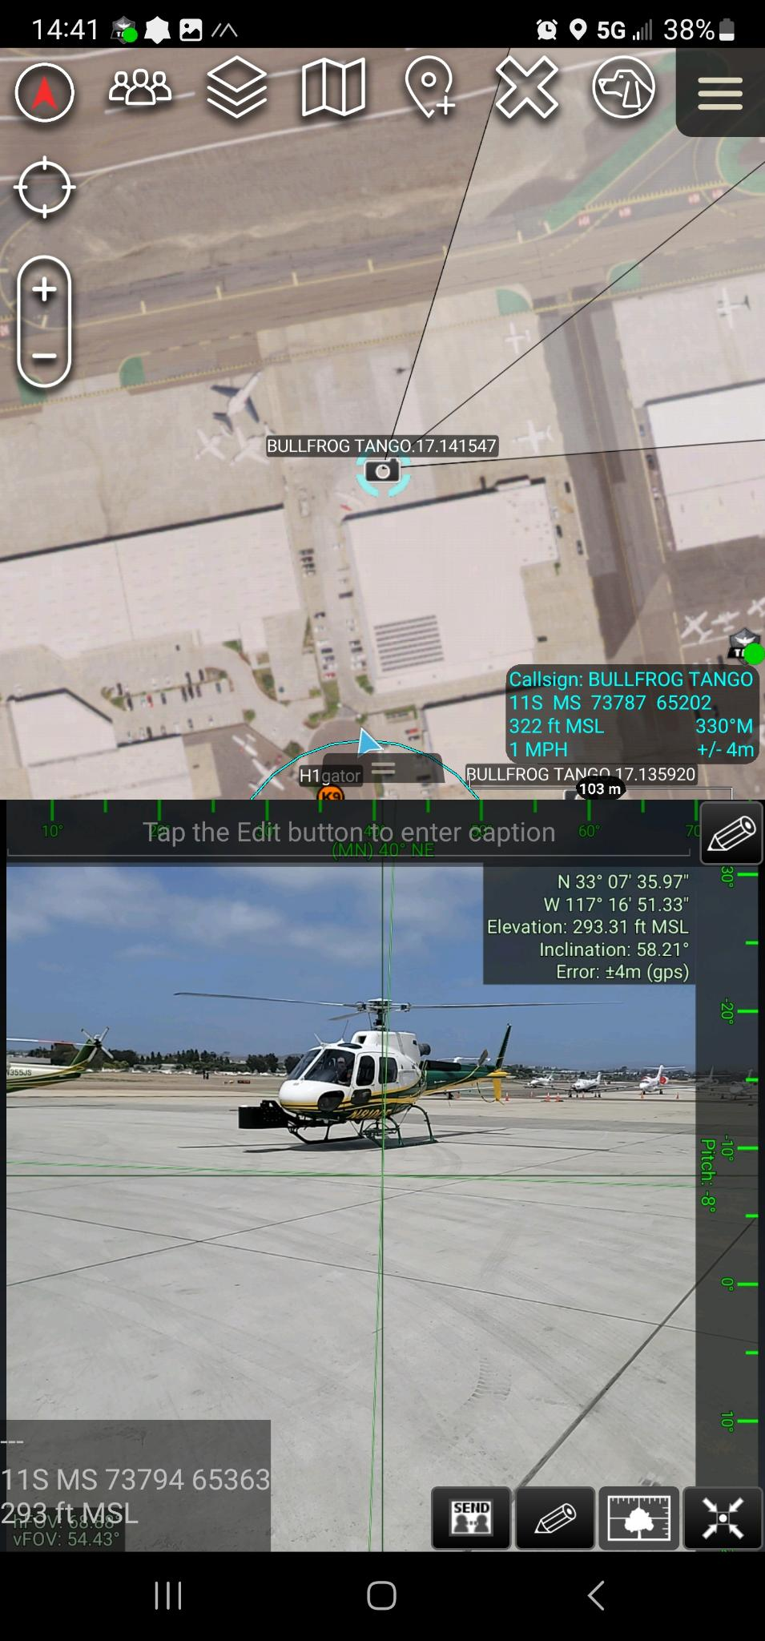
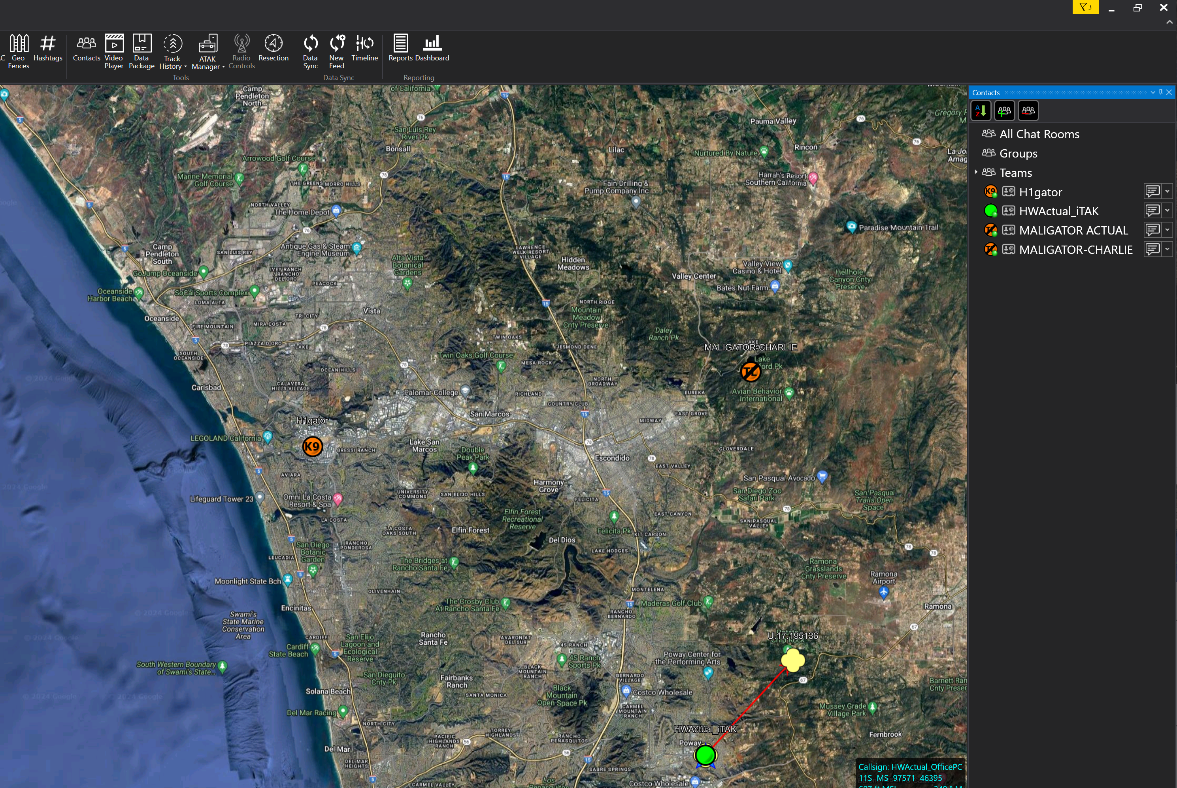
Capabilities:
Comms & Data Sharing
Notes:
Contacts with range & bearing
Send text messages
Send pics and videos
GeoCam can include other sensor data

Slide 8
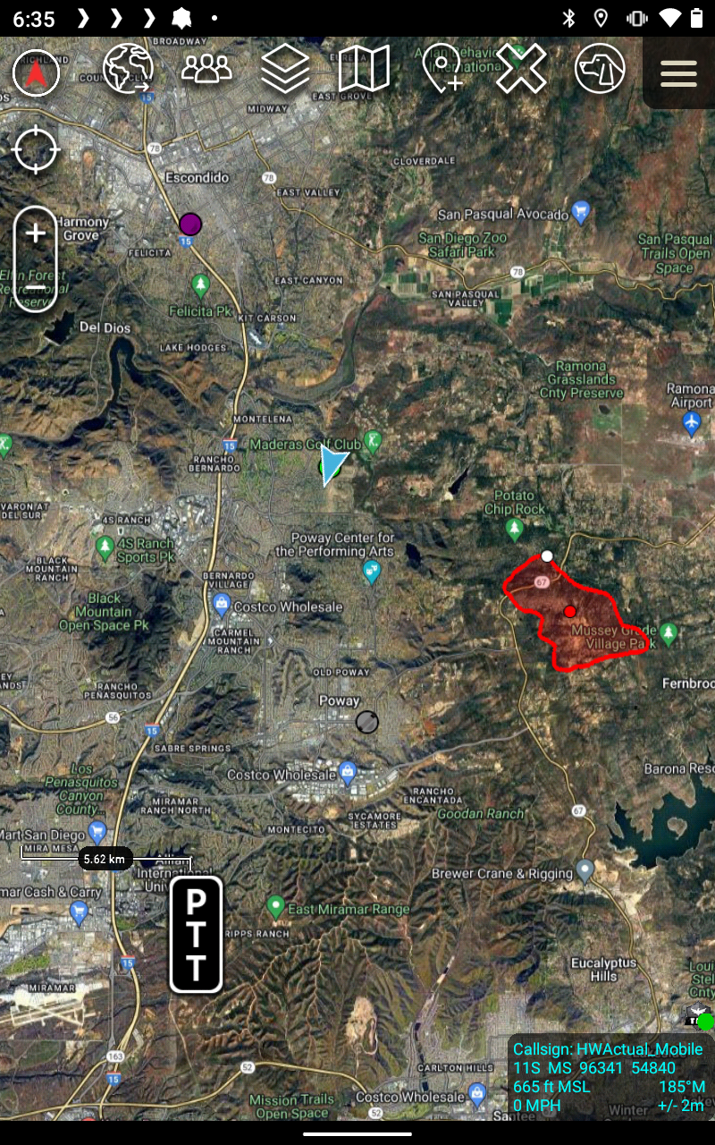
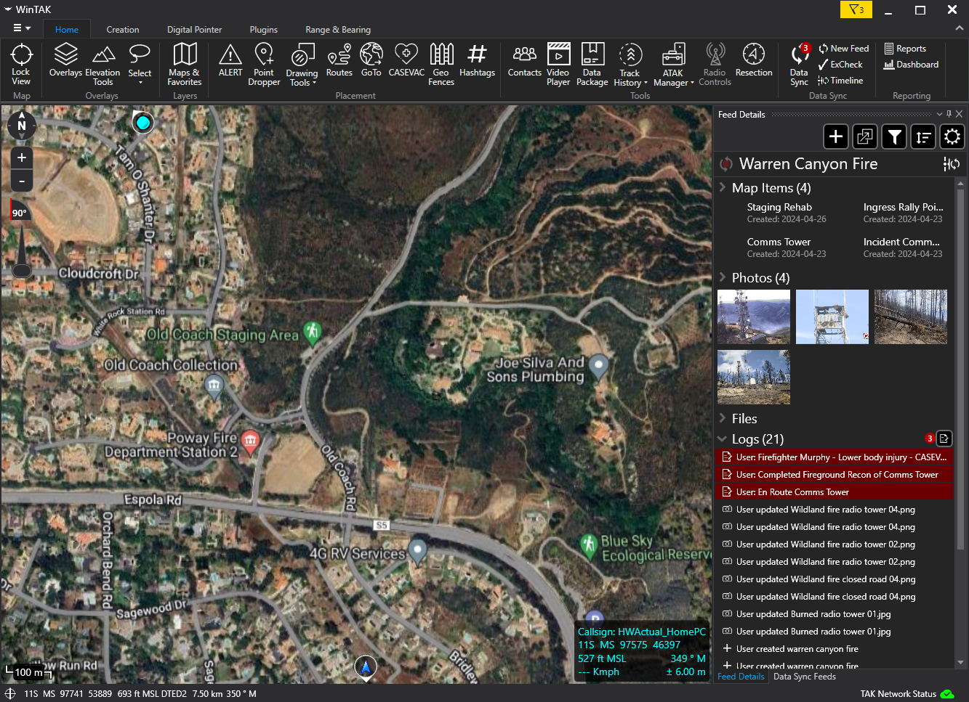
Capabilities:
Comms & Data Sharing
Notes:
Mumble plugin can enable voice comms
Data feeds for keeping up to date

Slide 9
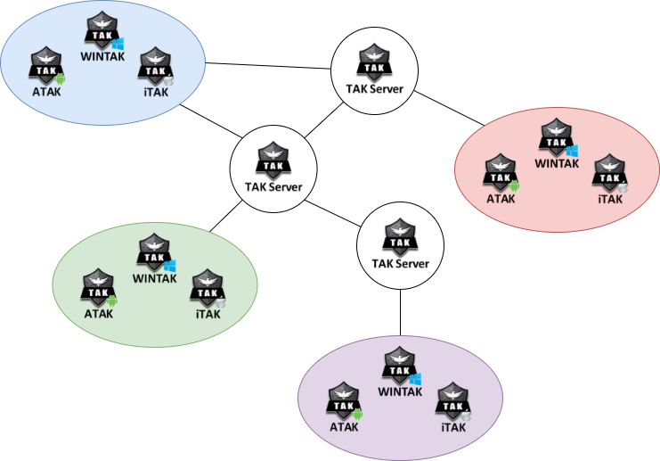
Setup:
Desired infrastructure:
Conventional internet based
SD-WAN (ZeroTier or equivalent)
Mobile ad hoc network (MANET)

Slide 10
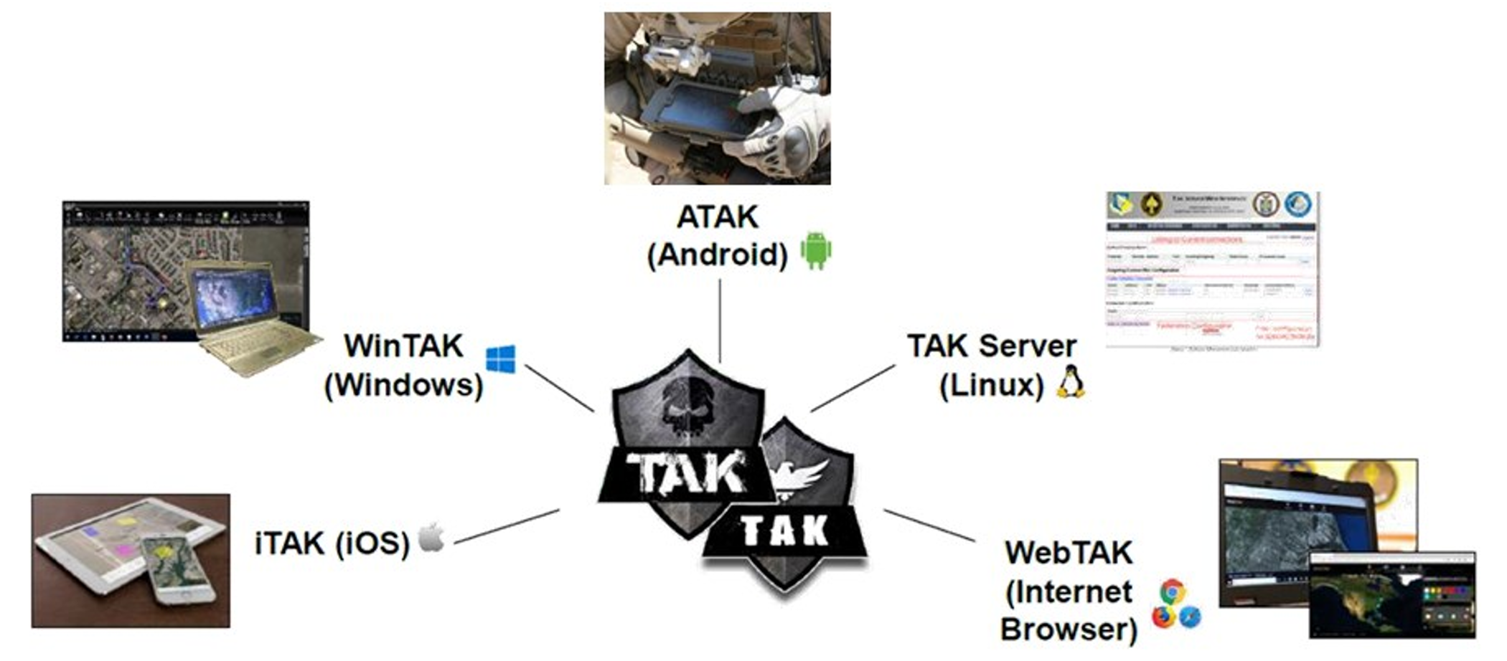
Setting up a TAK Server:
Use a public server
Use a private cloud-hosted server
Use a self-hosted PC running Ubuntu with some flavor of TAK server product
Use a self-hosted RPi running Ubuntu with a TAK server product installed

Slide 11
More Info:

